Slide 1
HTML - Marquees

Slide 2
Html Background with Colors
An HTML marquee is a scrolling piece of text displayed either horizontally across or vertically down your webpage depending on the settings. This is created by using HTML <marquees> tag.
<body>
<marquee>This is basic example of marquee</marquee>
</body>

Slide 3
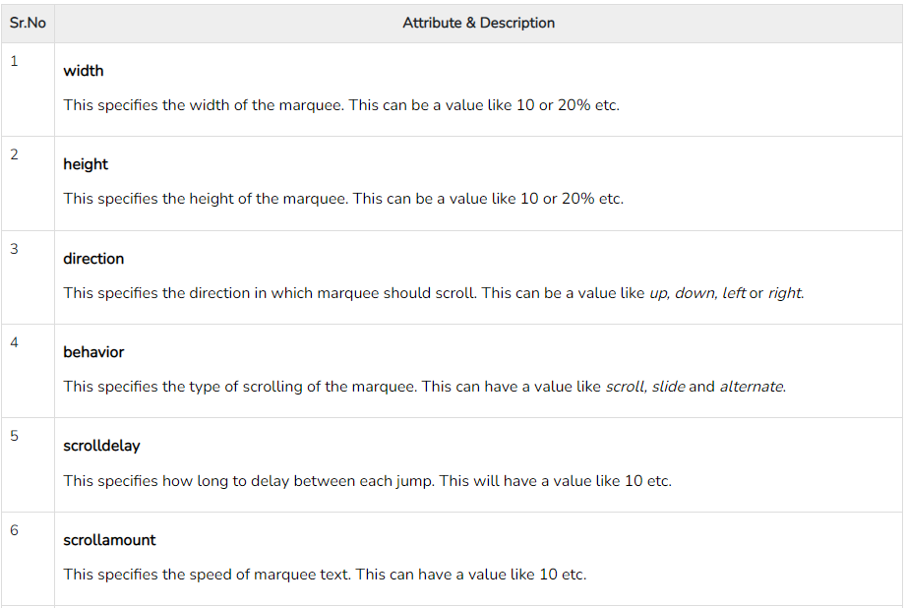
The <marquee> Tag Attributes
Following is the list of important attributes which can be used with <marquee> tag.

Slide 4
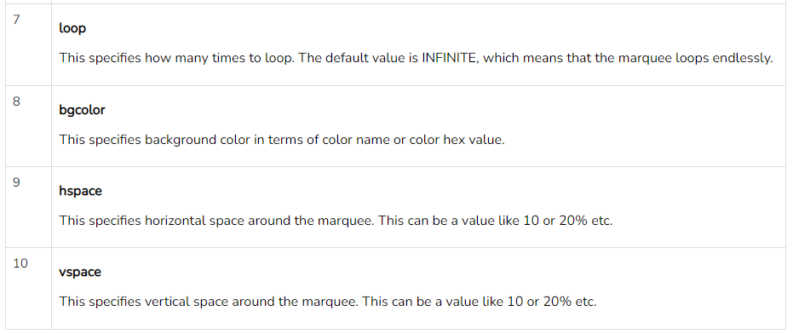

Slide 5
Example :
<marquee width = "50%">This example will take only 50% width</marquee>
<marquee direction = "right">This text will scroll from left to right</marquee>
<marquee direction = "up">This text will scroll from bottom to up</marquee>

Slide 6
HTML - Layouts

Slide 7
A webpage layout is very important to give better look to your website. It takes considerable time to design a website's layout with great look and feel.
Now-a-days, all modern websites are using CSS and JavaScript based framework to come up with responsive and dynamic websites but you can create a good layout using simple HTML tables or division tags in combination with other formatting tags.
HTML Layout - Using Tables
The simplest and most popular way of creating layouts is using HTML <table> tag. These tables are arranged in columns and rows, so you can utilize these rows and columns in whatever way you like.

Slide 8
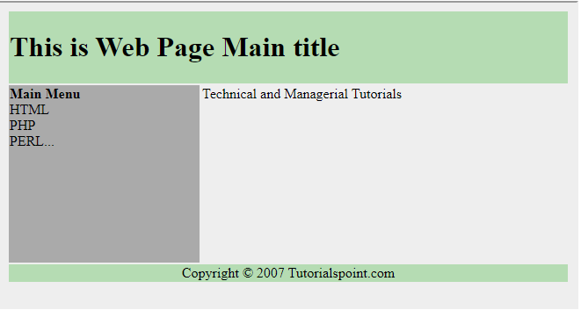

Slide 9
<body>
<table width = "100%" border = "0">
<tr>
<td colspan = "2" bgcolor = "#b5dcb3">
<h1>This is Web Page Main title</h1>
</td>
</tr>
<tr valign = "top">
<td bgcolor = "#aaa" width = "50">
<b>Main Menu</b><br />
HTML<br />
PHP<br />
PERL...
</td>
<td bgcolor = "#eee" width = "100" height = "200">
Technical and Managerial Tutorials
</td>
</tr>
<tr>
<td colspan = "2" bgcolor = "#b5dcb3">
<center>
Copyright © 2007 Tutorialspoint.com
</center>
</td>
</tr>
</table>
</body>

Slide 10
HTML Layouts - Using DIV, SPAN
The <div> element is a block level element used for grouping HTML elements. While the <div> tag is a block-level element, the HTML <span> element is used for grouping elements at an inline level.

Slide 11
<body>
<div style = "width:100%">
<div style = "background-color:#b5dcb3; width:100%">
<h1>This is Web Page Main title</h1>
</div>
<div style = "background-color:#aaa; height:200px; width:200px; float:left;">
<div><b>Main Menu</b></div>
HTML<br />
PHP<br />
PERL...
</div>
<div style = "background-color:#eee; height:200px; width:915px; " >
<p>Technical and Managerial Tutorials</p>
</div>
<div style = "background-color:#b5dcb3; clear:both">
<center>
Copyright © 2007 Tutorialspoint.com
</center>
</div>
</div>
</body>

